Slide 1
WISS Development

Slide 2
Authorization Demo

Slide 3
Program Navigation Group
DB Migration
Model
users
User
navigation_groups
NavigationGroup
navigation_groups
Navigation_Group

Slide 4
Learning steps
CRUD – Laravel
CRUS – ORM
Maintain permissions (Insert, update, delete, search)
Maintain users_permissions (ยาก) ดูด้วยกัน
new
 |  |  | action
v
E
D
Inserrt / Edit
Preview
Save

Slide 5
ER Diagram
 | user_permissions
PK,FK | Email
PK,FK | Per_id
 | Active
 | Create_at
 | Update_at
 | users
PK | Emp_id
 | Name
 | Email
 | Email_verified_at
 | Password
 | Remember_token
 | Active
 | Create_at
 | Update_at
 | user_permissions
PK | Id
FK | Email
FK | Permisson_id
 | Active
 | Create_at
 | Update_at
 | permissions
PK | Id
FK | Navigation_item_id
 | Name
 | Sequence
 | Active
 | Create_at
 | Update_at
M
M
1
1
M
1
 | navigation_groups
PK | Id
 | Name
 | Sequence
 | Active
 | Create_at
 | Update_at
 | navigation_items
PK | Id
FK | Navigation_group_id
 | Name
 | Sequence
 | Active
 | Create_at
 | Update_at
1
M

Slide 6
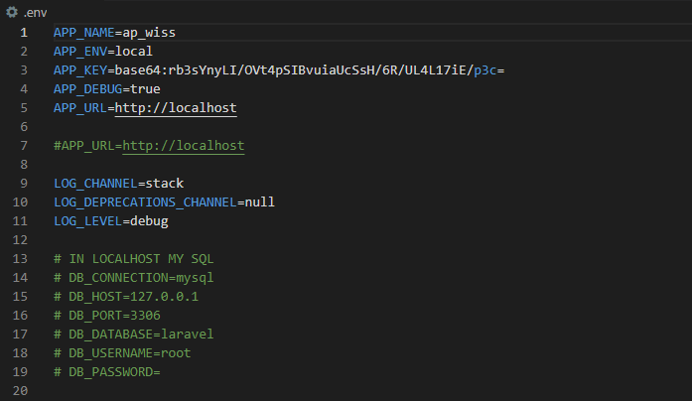
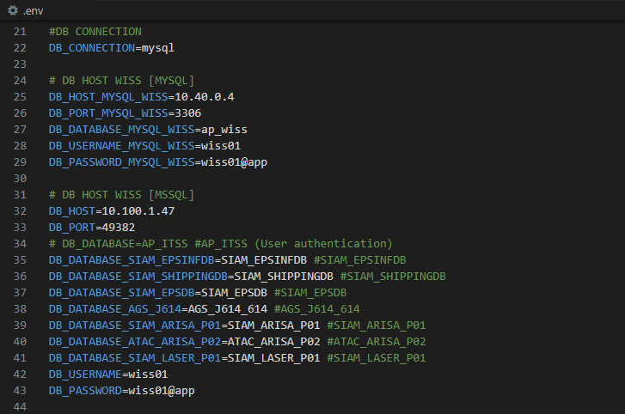
Config connection in Database

Slide 7
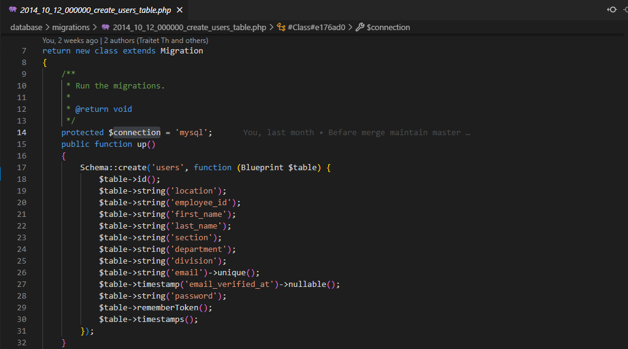
Coding for Database Migration to SQL

Slide 8
MVC
Model
Link to Database
Insert, update, delete, select
Relation
Column (Property)
Back-end
mysql
API
View
Controller
Laravel
Mobile
Front-end
Data Tier
(Model)
Business Logic
( function )
Presentation (View)

Slide 9
Navigation Design

Slide 10
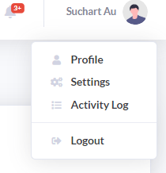
Database Design for Authorize
User: Suchart
Navigator Main (Nav Group) | Sub Navigator Sub (Nav Item) | Function (Collapse Item) | Permission
Business App Report | E-MFG | Order Status SA | True
Business App Report | EPS | NG Log SA | True
Maintain Application | I-BG | Add Dept | False
Maintain Application | I-BG | Add User | False
authorize
ER-diagram
users
(master)
functions
(master)
nav_items
(master)
nav_groups
(master)
User / function | Business Application Report | Function 2 | E-MFG | Function 4 | Function …
 | EPS | Function 2 | E-MFG | Function 4 | Function …
 | Function 1 | Function 2 | Function 3 | Function 4 | Function …
A |  |  |  |  | 
B |  |  |  | X | 
C |  |  | X |  | 
E |  | X |  |  | X
users_permissions (transaction)
Permission
(transaction)

Slide 11
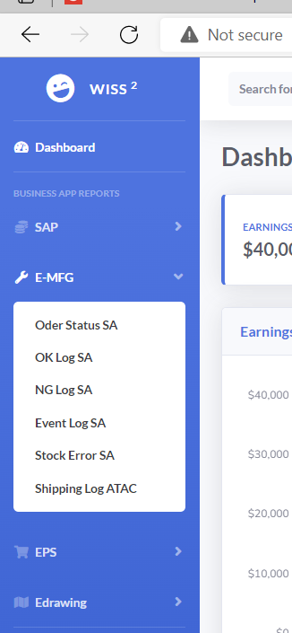
Database Design for Authorize
Navigator Main (Nav Group) | Sub Navigator Sub (Nav Item) | Function (Collapse Item) | Permission
Business App Report | SAP E-MFG EPS | Order Status SA OK Log SA NG Log SA | Y Y Y
Maintain Application | I-BG | Add Dept Add User Add Schedule | Y Y N
Render Navigation with authorization
navGroup
navItem
Authorize Front-end and Back-end (API)
collapseItem
(function)
collapseItem
(function)
collapseItem
(function)

Slide 12
Database Design for Authorize
Authentication
Front
Web API
Database
User/password
User/password
Token
Token
Authorization (Render Menu)
Front
User/token
Web API
User/password
Database
Authorization Matrix
Authorization Matrix
Authorization by each API
Client
Web API
Function#
Database
API
Success (200)
No authorize (401)
Permission

Slide 13
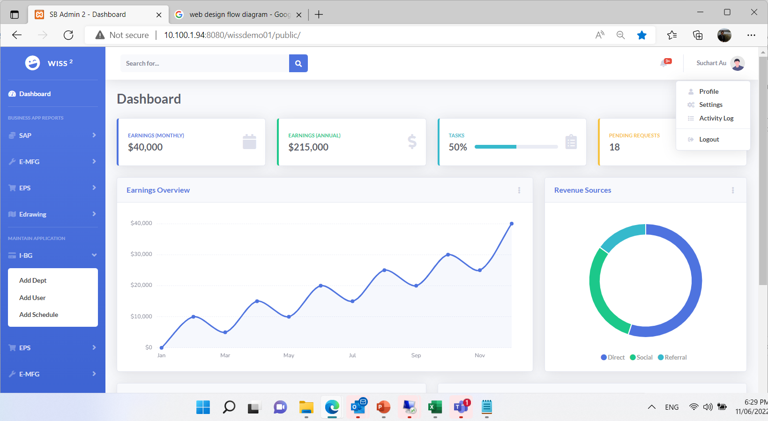
Site Flow Diagram
Login
Forgot Password
Home Page
Register
Edit Profile
Direct access API
(without permission)
Direct access Web (without permission)
No Authorize (Error 402)

Slide 14
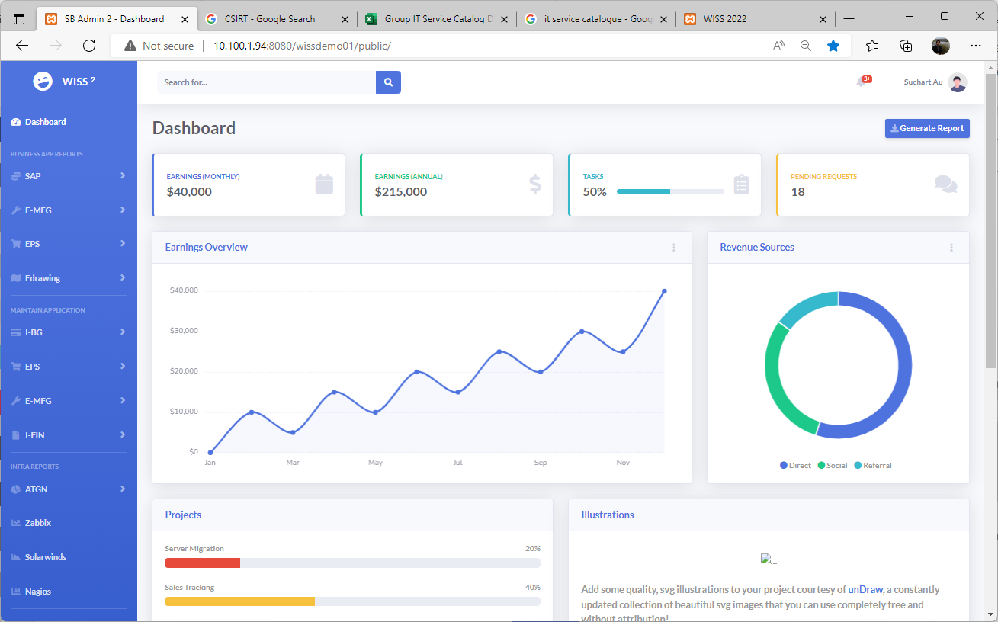
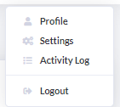
Login Flow Diagram
Login
Not login
Login
Register
Forgot Password
Logout
Login
Register Profile
Home Page

Slide 15
Open git base here [Create breeze project] $composer create-project laravel/laravel testdemo02
$composer require laravel/breeze --dev
$php artisan breeze:install
[Install JS,CSS]
$cd testdemo02
$npm install
$npm run dev
[Create DB]
$php artisan migrate
Register Password
Send Mail
Render Menu
Login
Forgot Password
Edit Profile
Profile
Change Password
Task
-Send mail
-Render menu
-Model
-Redirect to login (If no session)

Slide 16
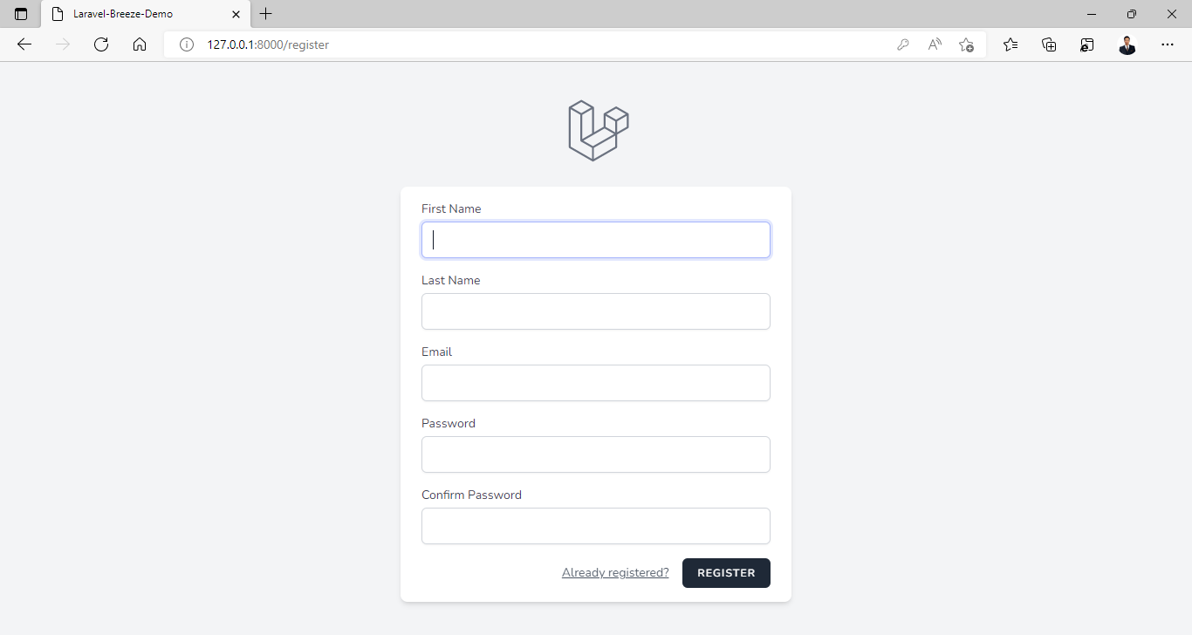
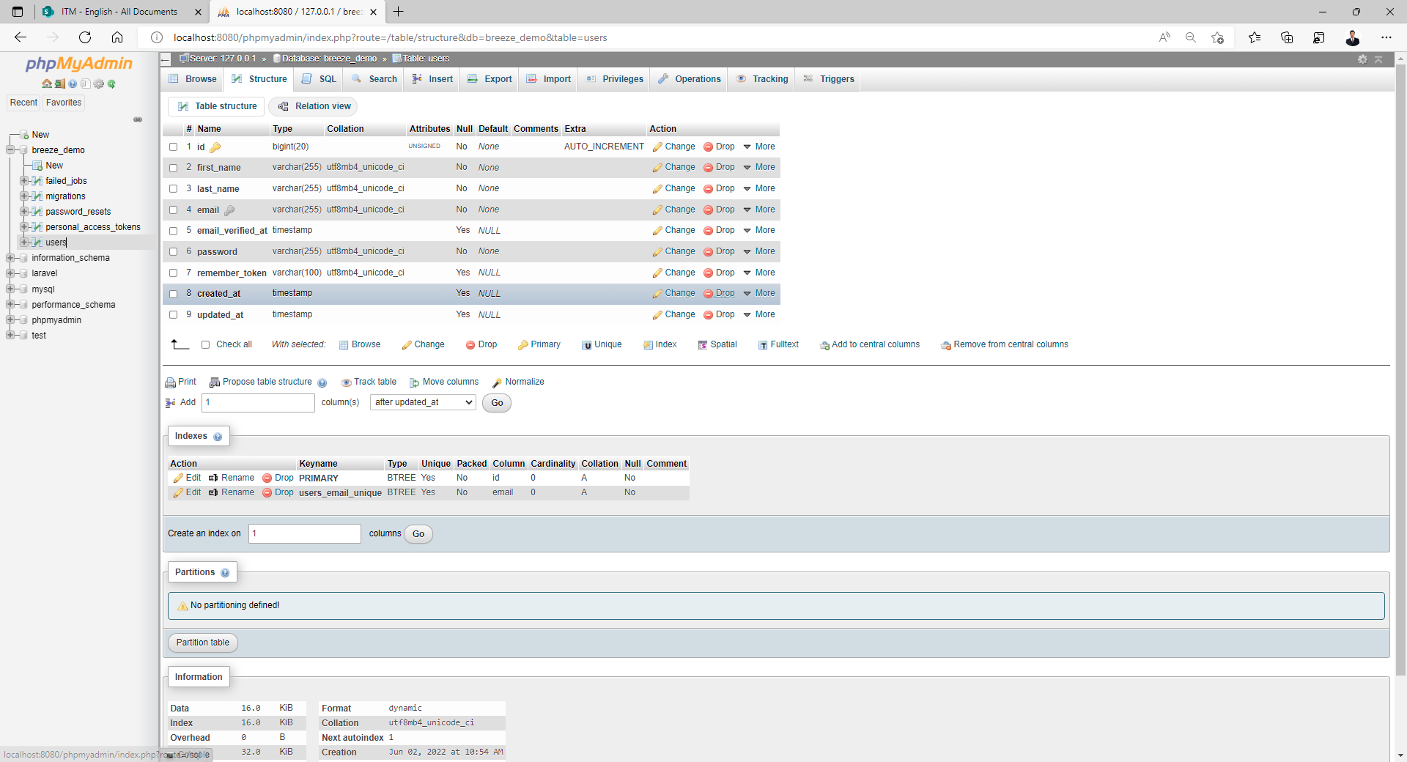
add firstname & lastname
$Add $table->string(last_name)
$php artisan migrate:fresh
Migrate DB, Create model and controller
$php artisan make:migration create_navigation_groups_table --create=navigation_groups
$php artisan migrate:refresh --path=/database/migrations/2022_06_23_123052_navigation_groups_table.php
$php artisan make:controller NavigationGroupController --resource --model=NavigationGroup

Slide 17
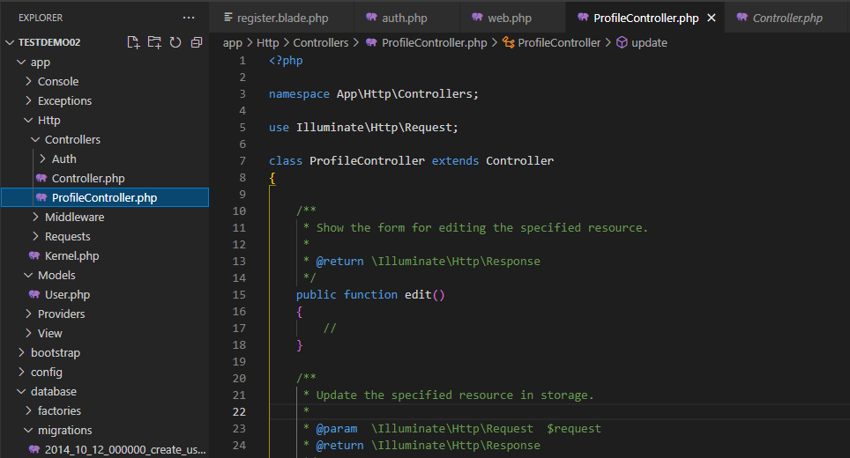
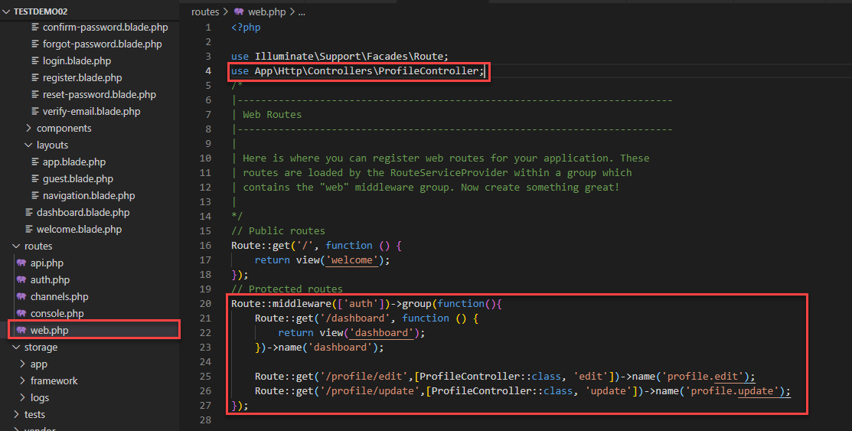
add Edit user profile
1) $php artisan make:controller ProfileController –r
2)Edit route

Slide 18
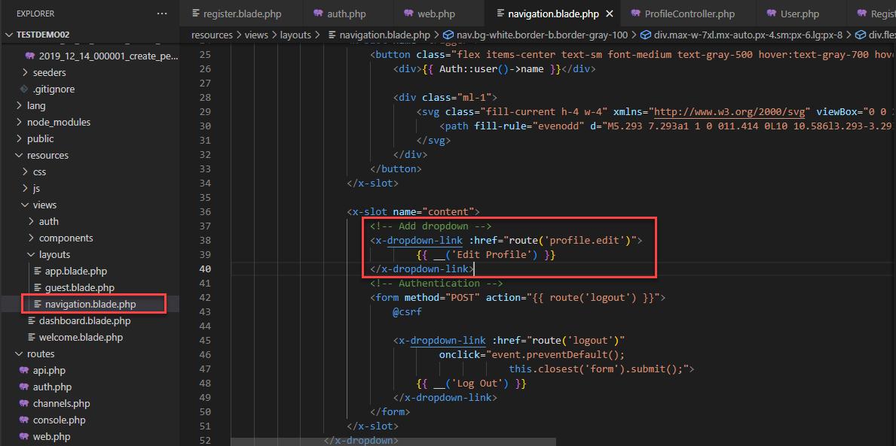
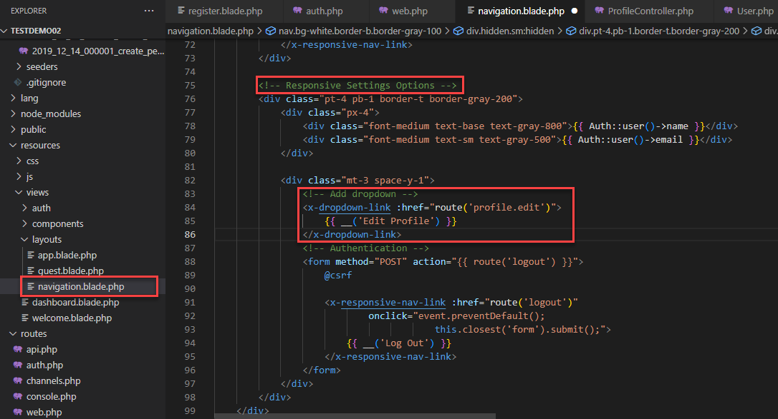
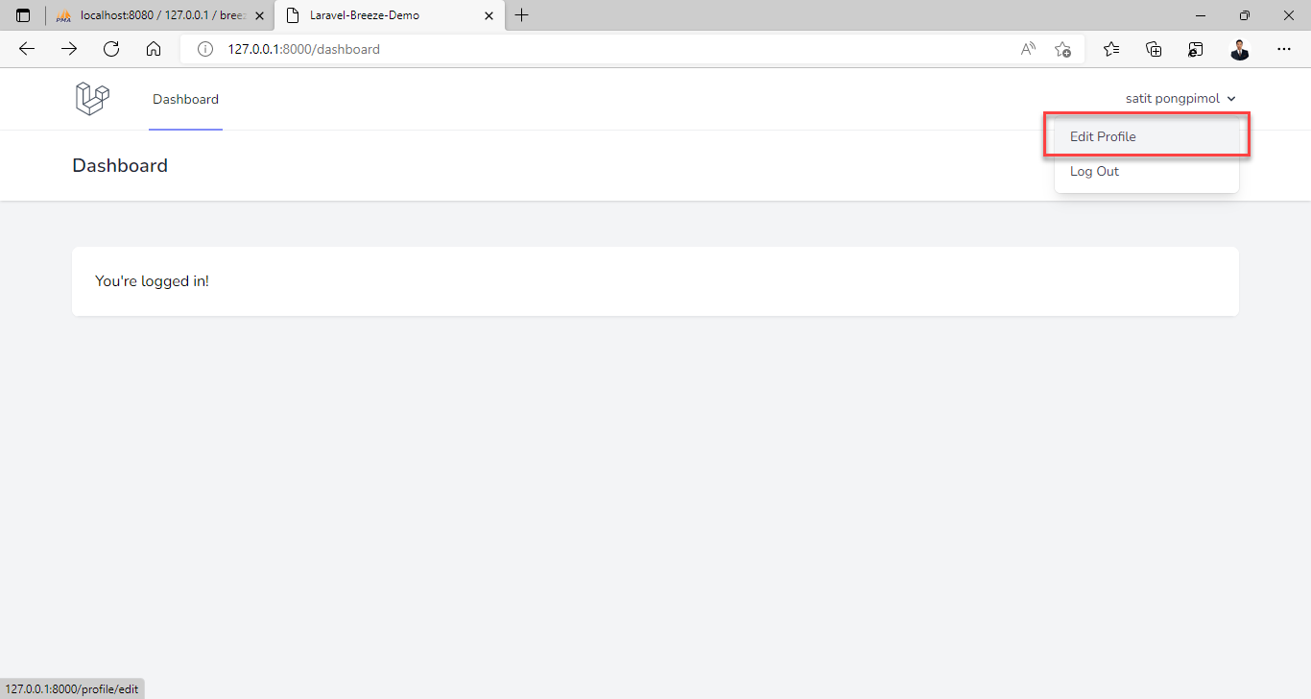
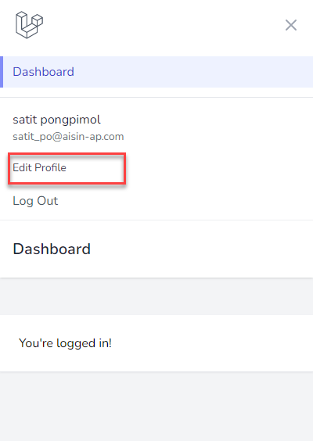
add Edit user profile
1) Edit navigation
2)Edit navigation responsive

Slide 19
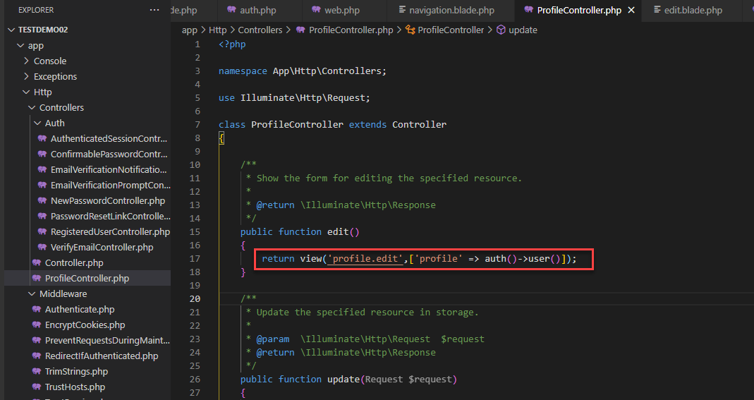
add Edit user profile
1) Edit ProfileController
2)Create view (Copy from bashboard and register php) 3)install flash ($composer require josegus/laravel-flash)

Slide 20
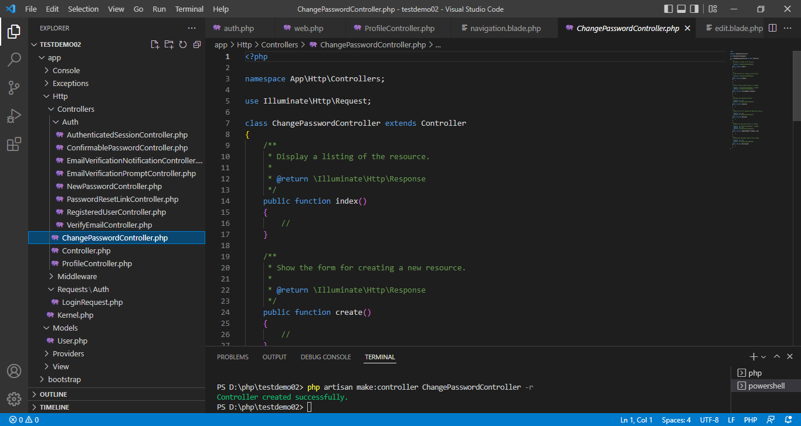
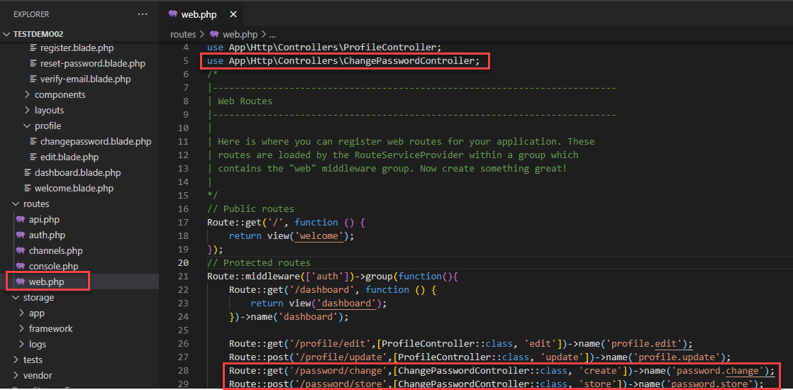
add Change password
1) $php artisan make:controller ChangePasswordController -r
2)Edit route

Slide 21
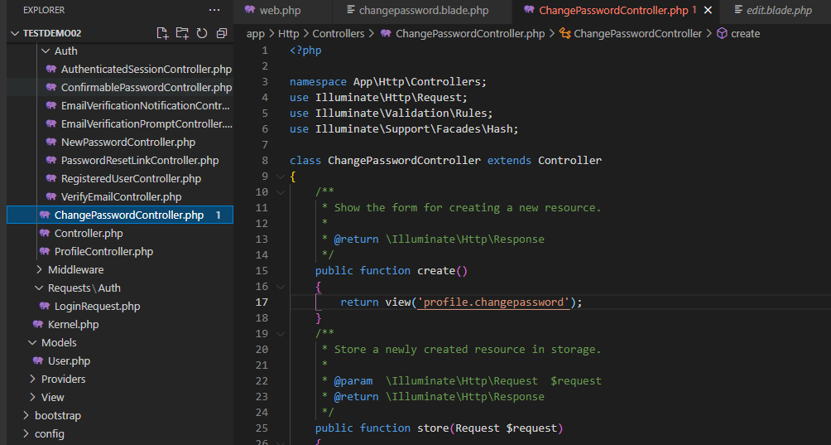
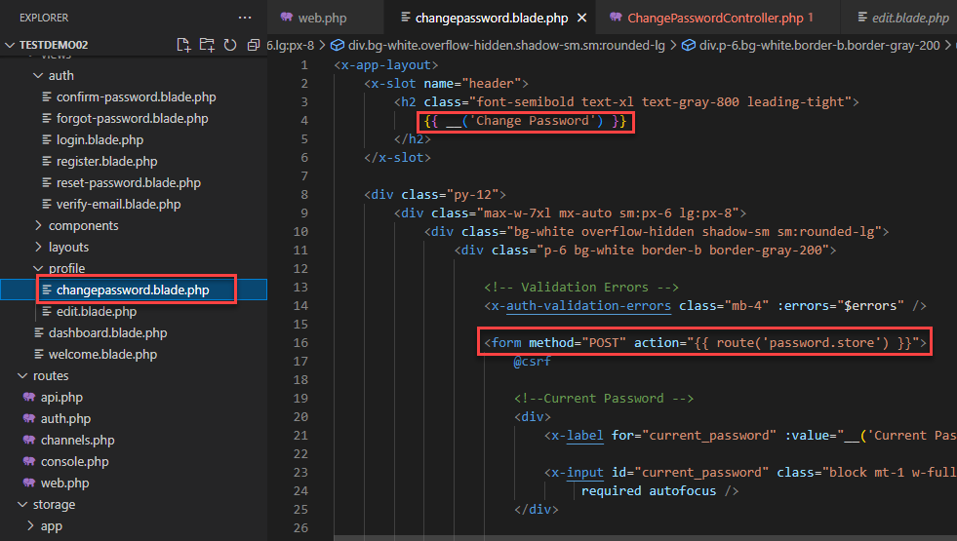
add Change password
1) Edit ChangePasswordController
2)Create view (Copy from bashboard and register php) 3)install flash ($composer require josegus/laravel-flash)

Slide 22
[ WISS Plan ]
#Authorization (Web api, UI)​ ➔ 06/2022
UI Design (Login, forgot password, authorization) ➔ 14/06/2022 [P’New]​
System Design​ ➔ 14/06/2022 [P’Nueng&Chart&P’Oat]
Clone code in DEV ➔ 10/06/2022
System Development​ (Merge code) ➔ 11/06/2022
Render menu (DB+User role base concept)➔ 18/06/2022
#Move to Azure DevOP​ ➔ 08/2022
#Move to Azure Cloud ➔ 08/2022

Slide 23
[ WISS Plan 12/07/2022 ]
#Next step
Training IT support [Chart] ➔
Transfer to user​ [P’New] ➔

Slide 24
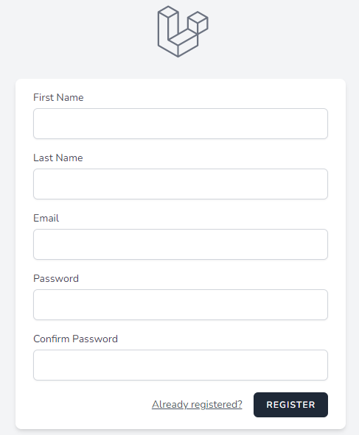
[ Register ]
Schema
ID
First Name
Last Name

Slide 25
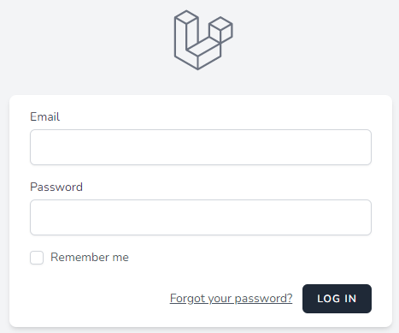
[ Login ]
Schema
Email
Password

Slide 26
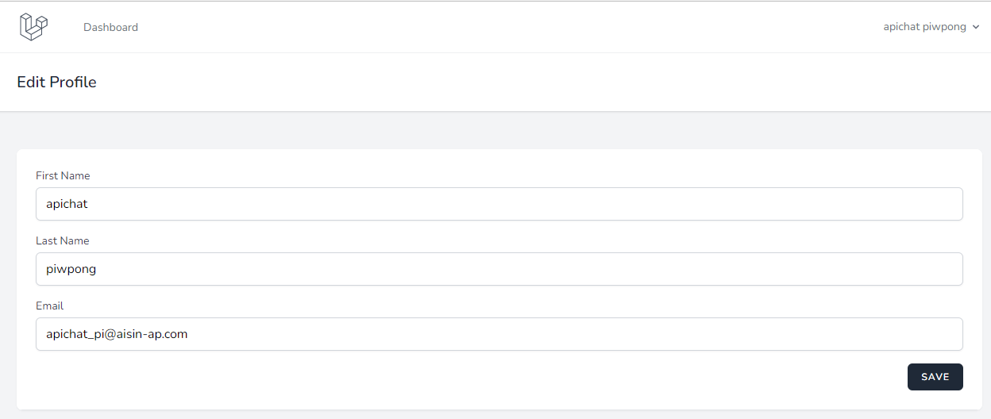
[ Edit Profile ]

Slide 27
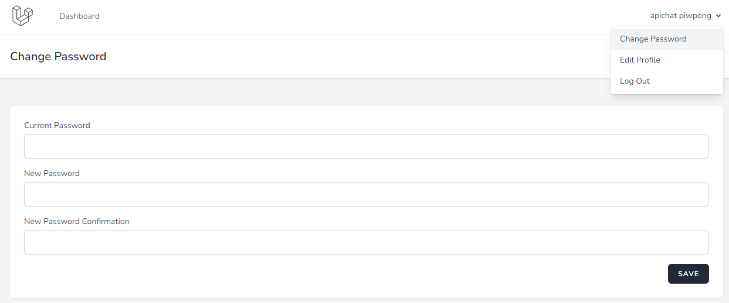
[ Change Password ]

Slide 28
Dashboard Demo

Slide 29
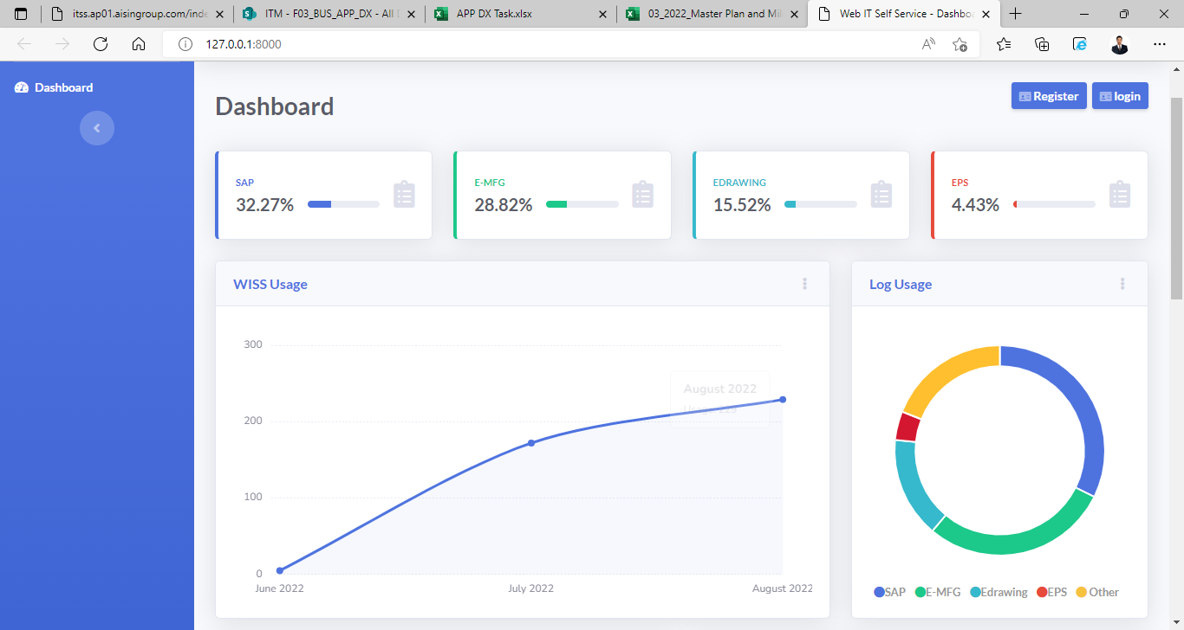
Top 4 application usage

Slide 30
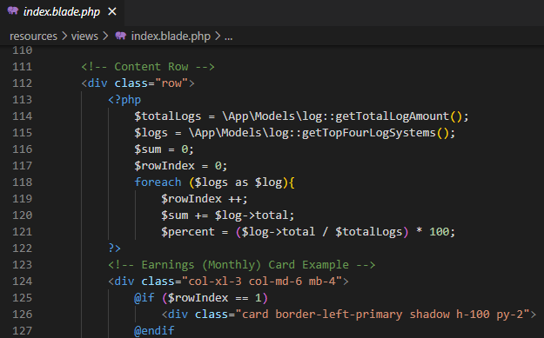
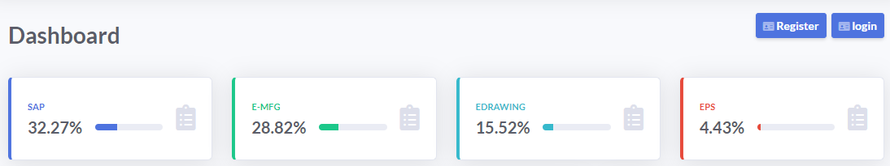
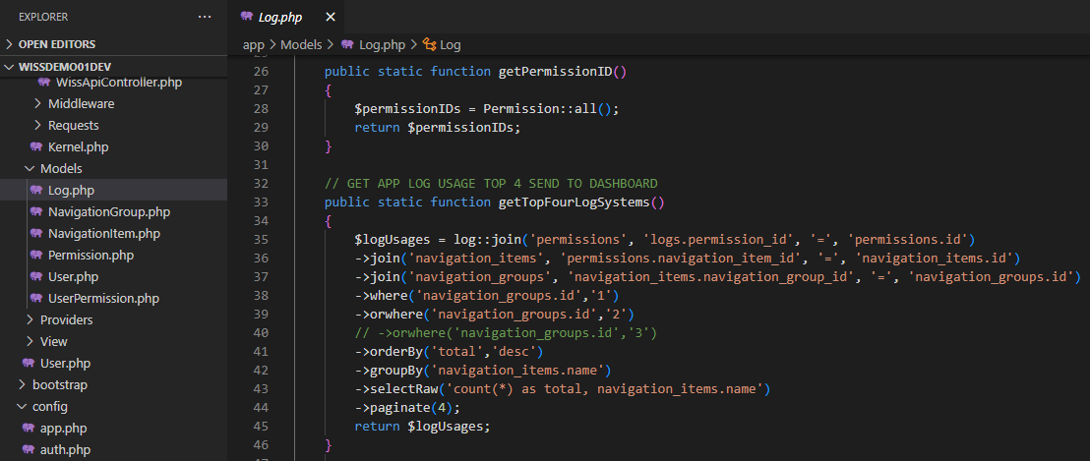
Top 4 application usage

Slide 31
Authorization Demo

Slide 32
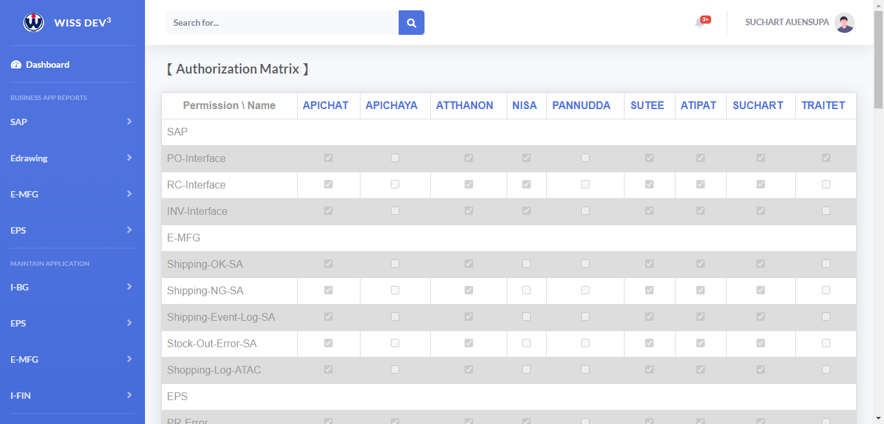
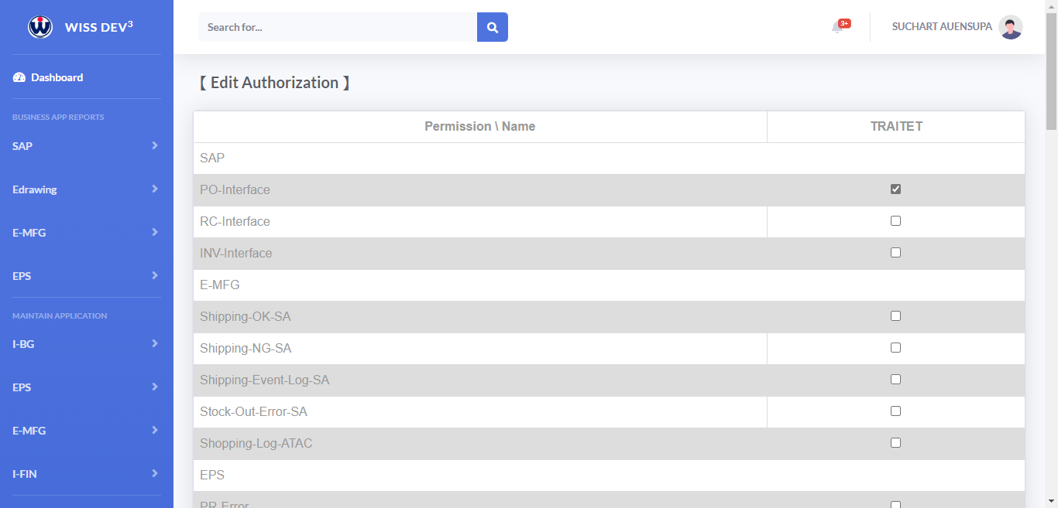
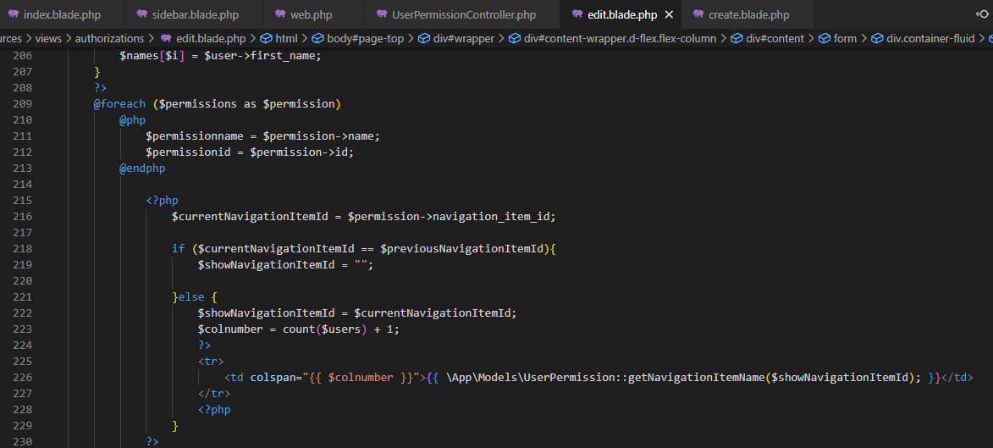
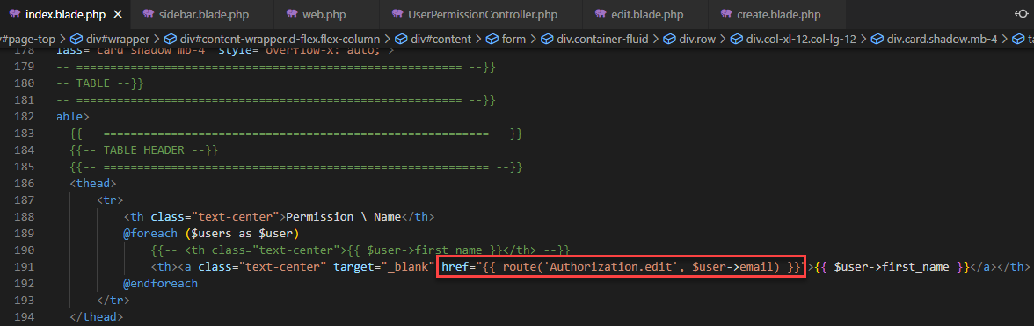
Authorization Matrix (CR)

